Slide 1
Model Evaluation using
Iris Data Set
Term 3 GCD
by Aditya AVS

Slide 2
Story
The Iris dataset was used in R.A. Fisher's classic 1936 paper, The Use of Multiple Measurements in Taxonomic Problems, and can also be found on the UCI Machine Learning Repository.
It includes three iris species with 50 samples each as well as some properties about each flower. One flower species is linearly separable from the other two, but the other two are not linearly separable from each other.
The columns in this dataset are:
Id
SepalLengthCm
SepalWidthCm
PetalLengthCm
PetalWidthCm
Species - Iris Setosa, Versicolour, Virginica

Slide 3
Problem Statement
It is one of the very famous classification problems.
Given Sepal and Petal - lengths and width we are supposed to predict the class of Iris (Setosa, Versicolour, Virginica)

Slide 4
Analysis
The dataset provided has 150 rows
Dependent Variables : Sepal length, Sepal Width, Petal length, Petal Width
Independent/Target Variable : Species
Missing values : None
The Id parameter was dropped
<class 'pandas.core.frame.DataFrame'>
RangeIndex: 150 entries, 0 to 149
Data columns (total 6 columns):
Id 150 non-null int64
SepalLengthCm 150 non-null float64
SepalWidthCm 150 non-null float64
PetalLengthCm 150 non-null float64
PetalWidthCm 150 non-null float64
Species 150 non-null object
dtypes: float64(4), int64(1), object(1)
memory usage: 7.1+ KB

Slide 5
EDA
As stated, it has data about three iris species Iris-setosa, Iris-versicolor and Iris-virginica with each 50 samples.
Using SepalLengthCm and SepalWidthCm correlation,
Setosa flowers can be distinguished from others
It is difficult to differentiate Versicolor from Viginica as they have considerable overlap
Using Correlation between PetalLengthCm and PetalWidthCm features,
All the three flower species can be differentiated
From the Heatmap, it seems that all features have either strong positive or negative correlation with the Species that we want to classify.

Slide 6
ML Models used
Random Forest Regressor
Without PCA
After PCA
K-Nearest Neighbours
SVM
SVR
Linear SVC
SVC

Slide 7
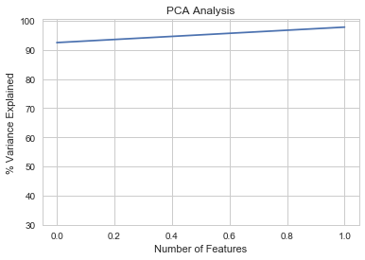
Model Evaluation - PCA
Random Forest Regressor
Without PCA
MAE is 0.13999999999999999
RMSE is 0.30441200151548997
After PCA
2 components explain 95% of the variation in data
MAE is 0.14666666666666667
RMSE is 0.35023801430836526

Slide 8
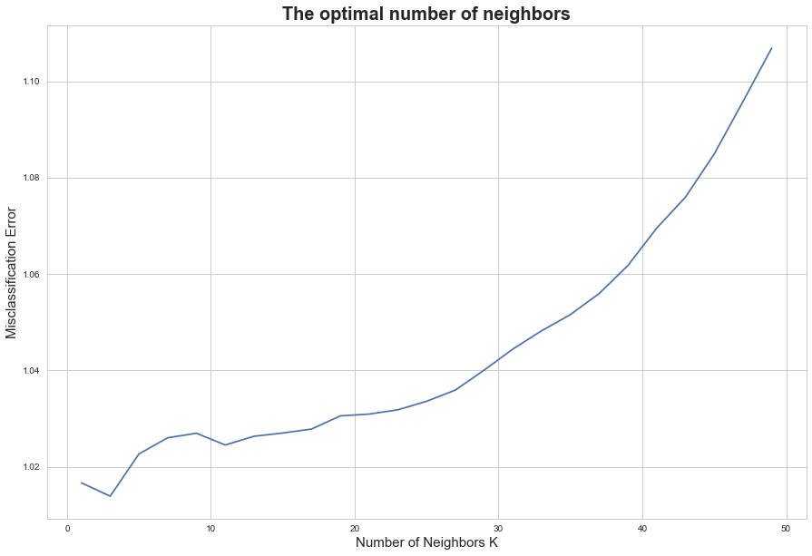
Model Evaluation - KNN
KNN
Accuracy of 93.33%
MAE is 0.14666666666666667
RMSE is 0.35023801430836526
Optimal number of neighbours
3

Slide 9
Model Evaluation - SVM
SVM
SVR
Accuracy on training set: 79.95
Accuracy on test set: 74.99
Linear SVC
Accuracy on training set: 95.83
Accuracy on test set: 86.67
SVC
Accuracy on training set: 98.33
Accuracy on test set: 90.00

Slide 10
Conclusion
PCA doesnt seem to have much impact due to the lesser number of components and less variance.
The optimal number of neighbors for using in KNN algo is 3.
The accuracy of KNN model is 93%.
SVC Model (SVM) seems to be having higher accuracy for training set but for test data it is only 90%.
KNN Model seems to be better for predicting as far as this data set is considered.

